Slide 1
Acknowledgement Internet Images, available in Public Domain, have been used in many Slides of this Presentation. Some of the Images have also been Modified/Superimposed. Used only for Academic Purpose/Understanding.

Slide 2
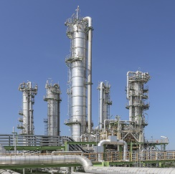
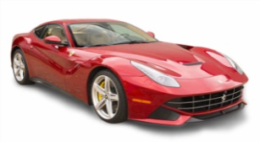
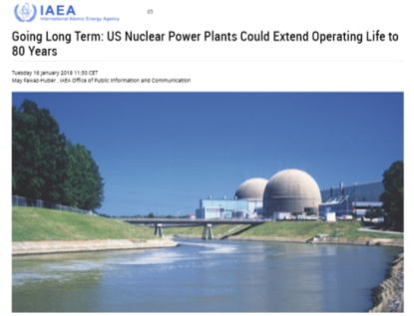
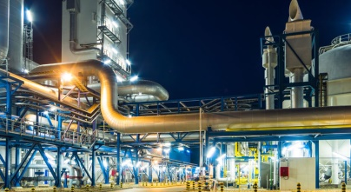

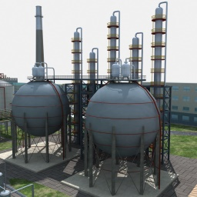
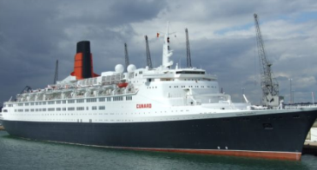
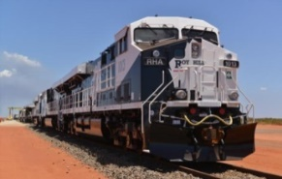
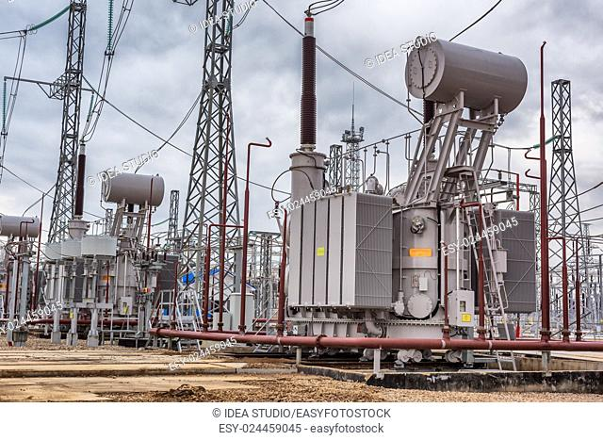
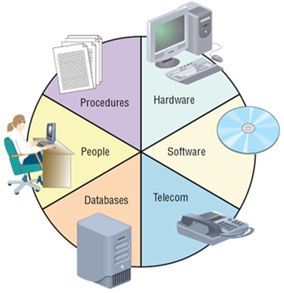
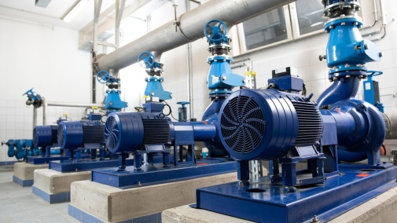
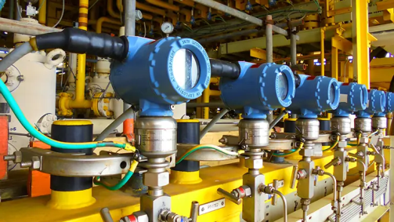
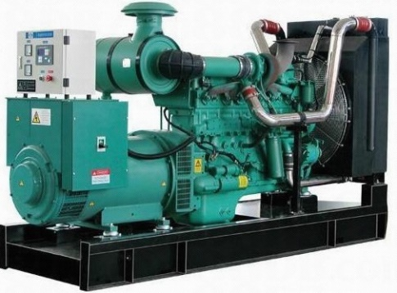
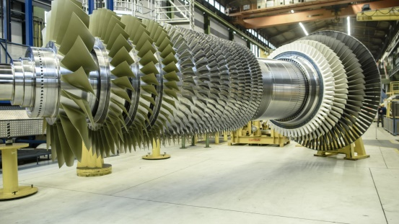
Typical Industrial Complex/Process Plant/Transportation Vehicle
Mechanical/ Structures, Piping, Roto-Dynamic Eqpt., DGs,
Process Eqpt. etc.
Electrical, Power Supplies/VFDs, Power Devices, DGs, etc.
Instrumentation, Process Sensors, Chemical-Electro-Chemical, Domain-specific Inst.
Computer based Systems, Embedded Real-time Sys. & OS, DAC, Historians, Alarm-Trip Annunciations, etc.

Slide 3
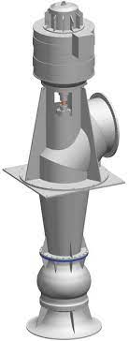
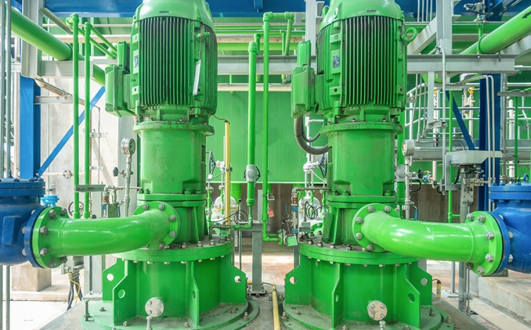
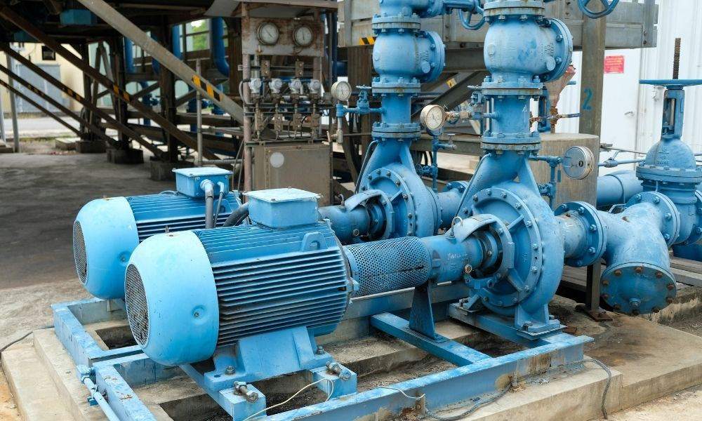
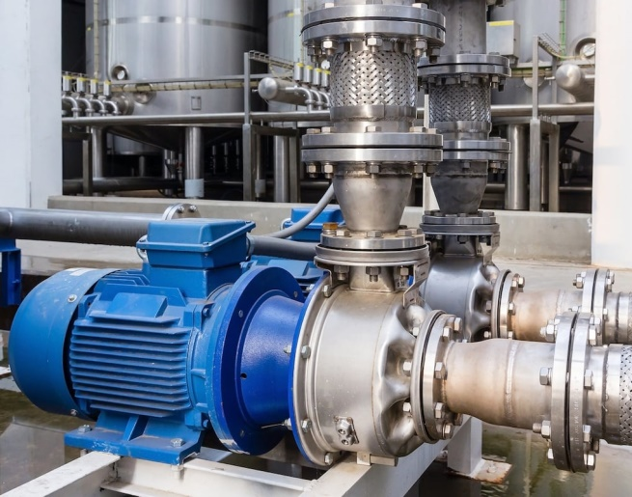
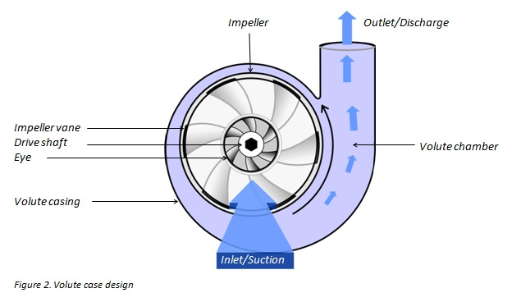
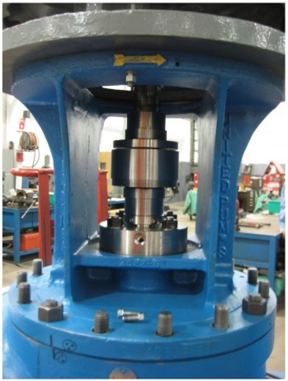
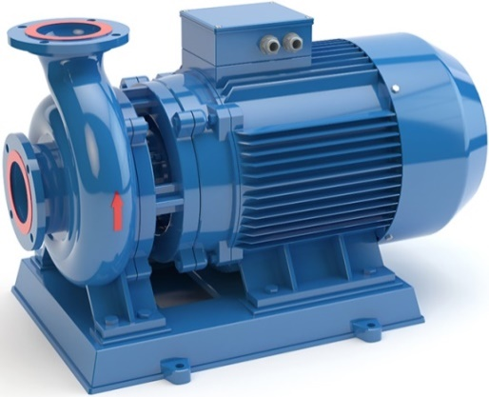
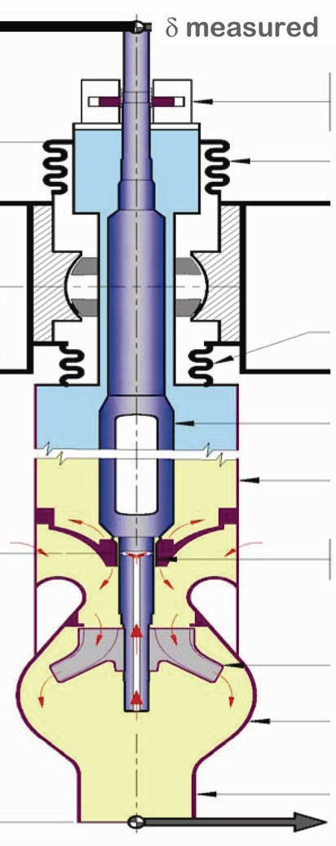
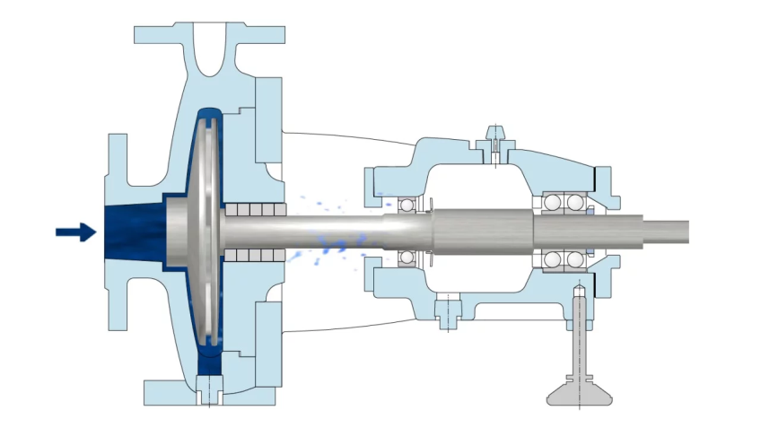
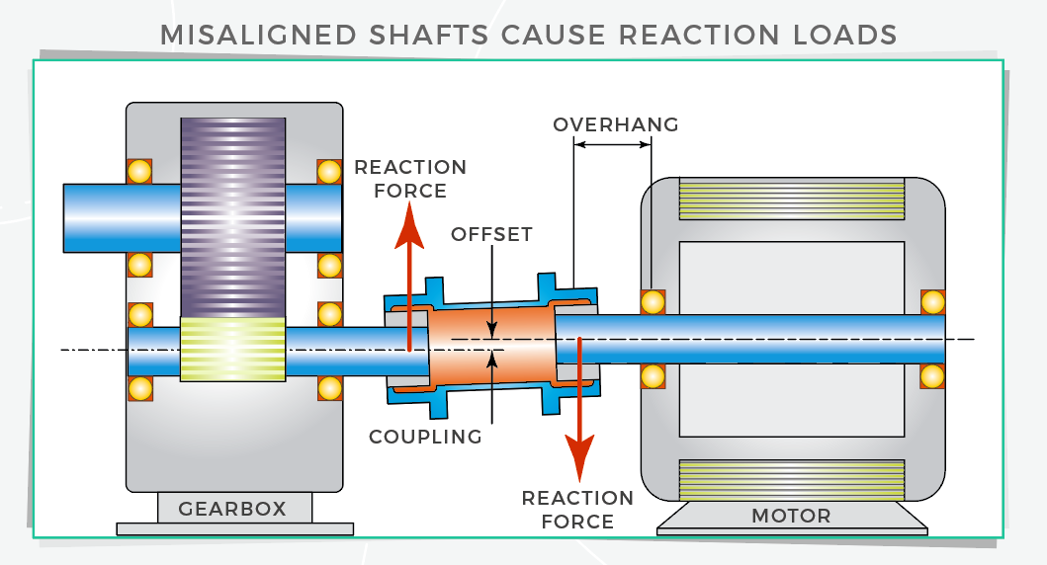
Mechanical/ Roto-Dynamic Eqpt
Roto-Dynamic Eqpt --- (I/P-O/P) ODE/PDE Models, Eigen-structures of Shafts , Thrust/Radial Bearing Models, Hydro-Dynamic & Hydro-Static Bearing Models

Slide 4
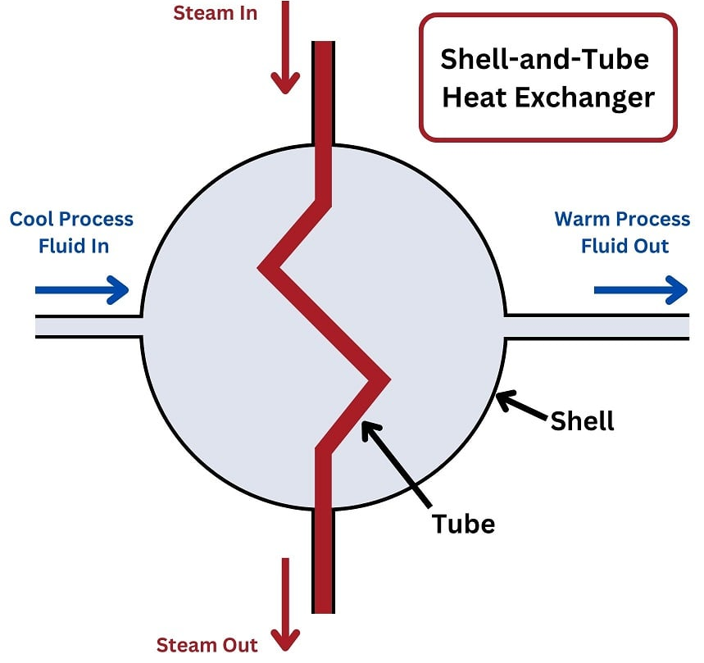
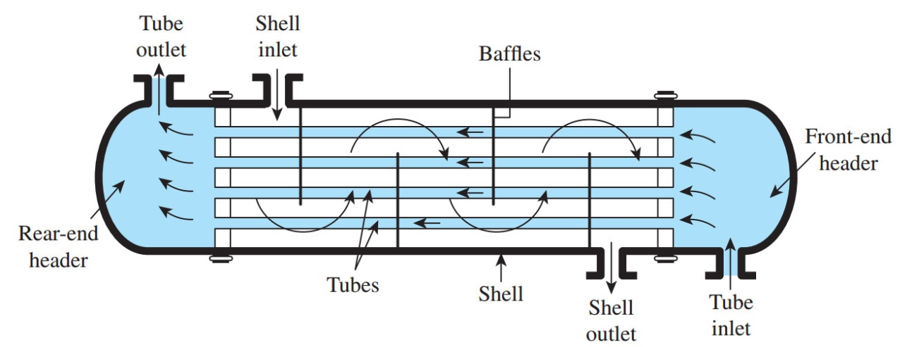
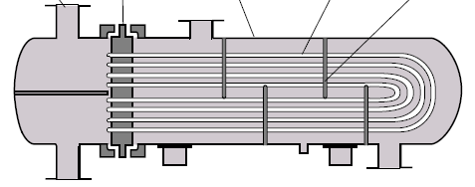
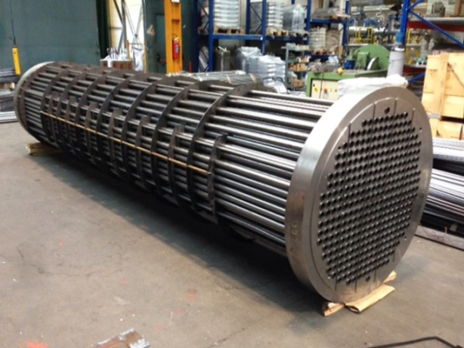
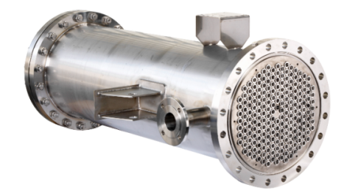
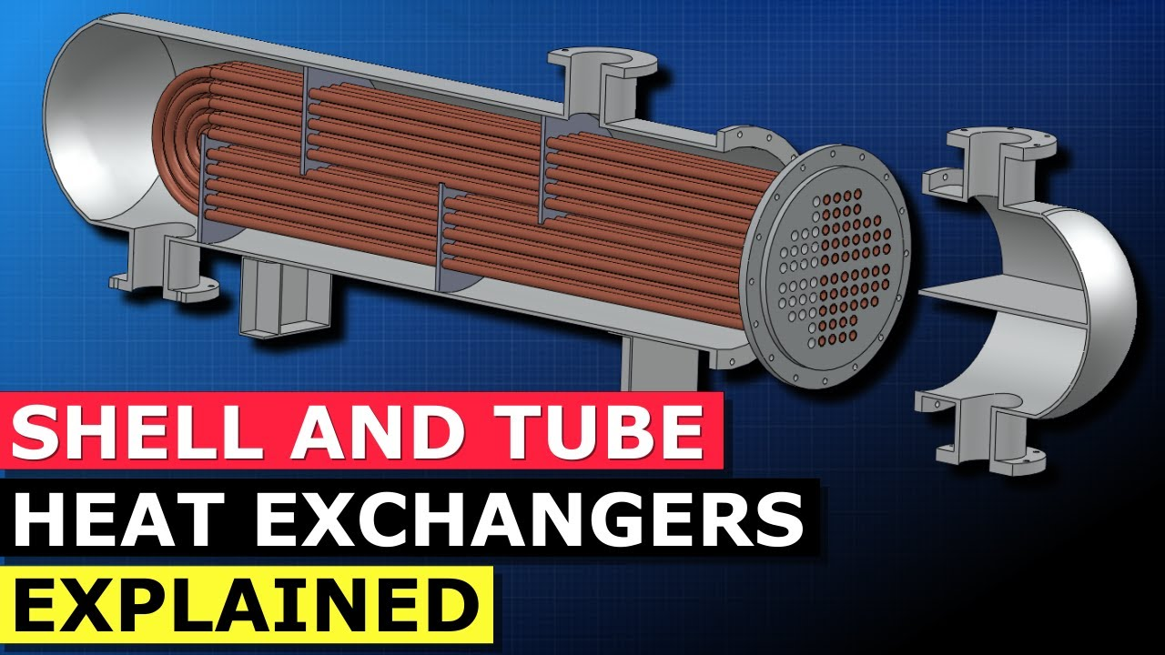
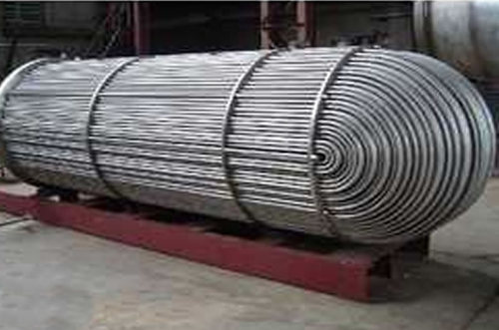
Mechanical/ Process Eqpt.
Heat & Mass Transfer Models

Slide 5
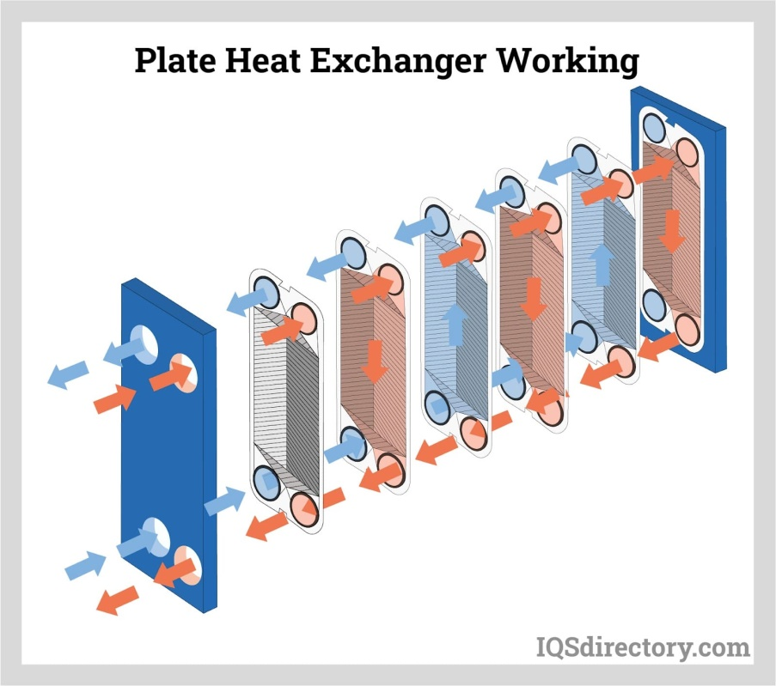
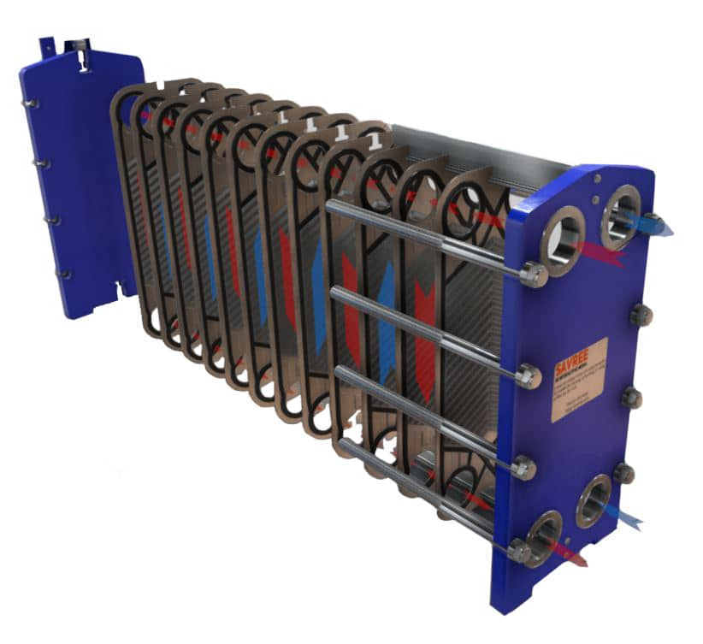
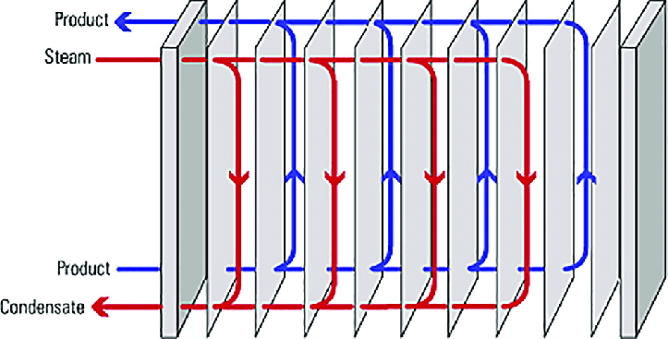
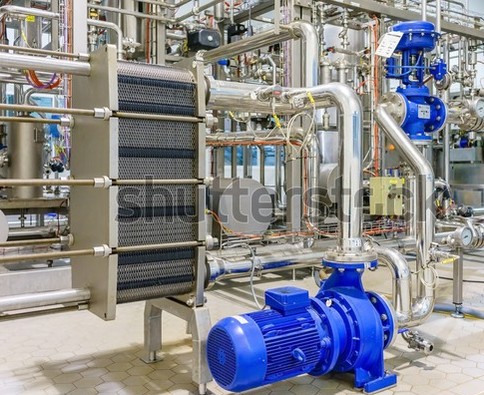
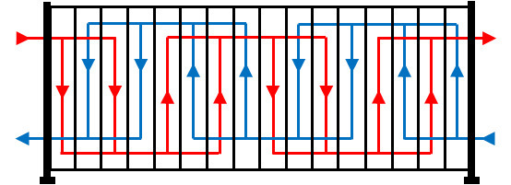
Mechanical/ Process Eqpt.
Heat & Mass Transfer Models

Slide 6
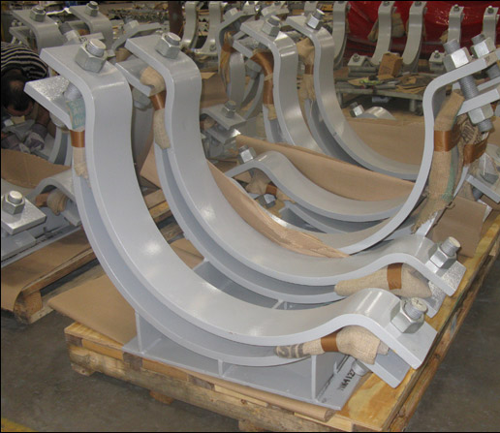
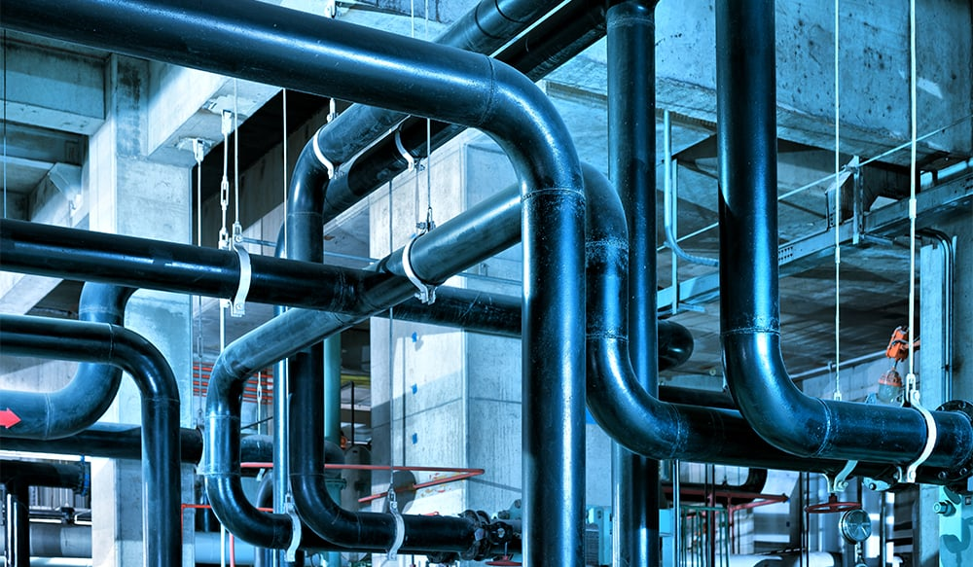
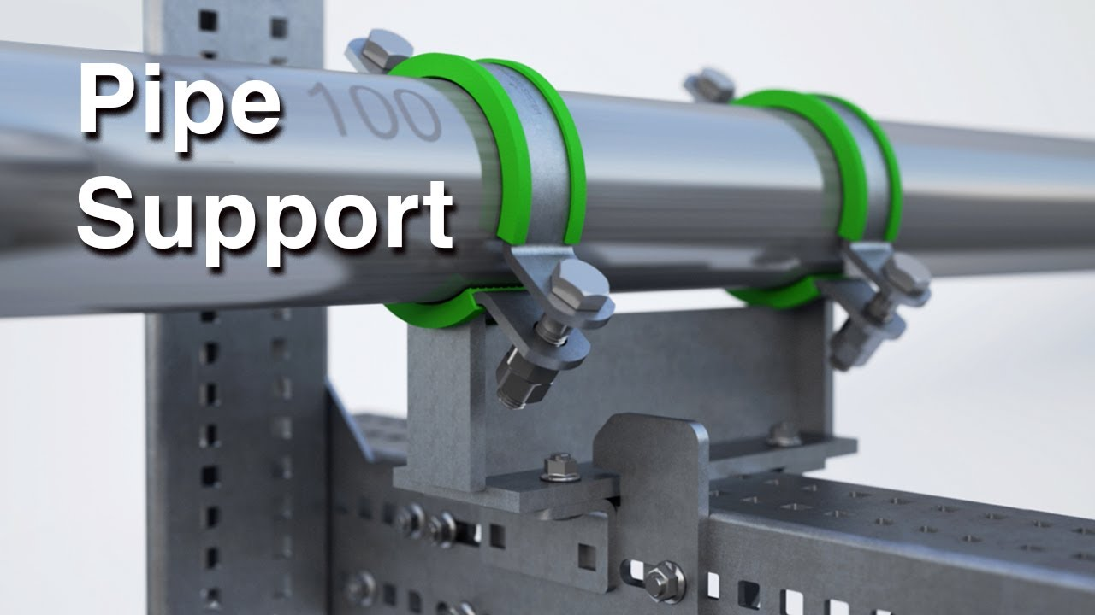
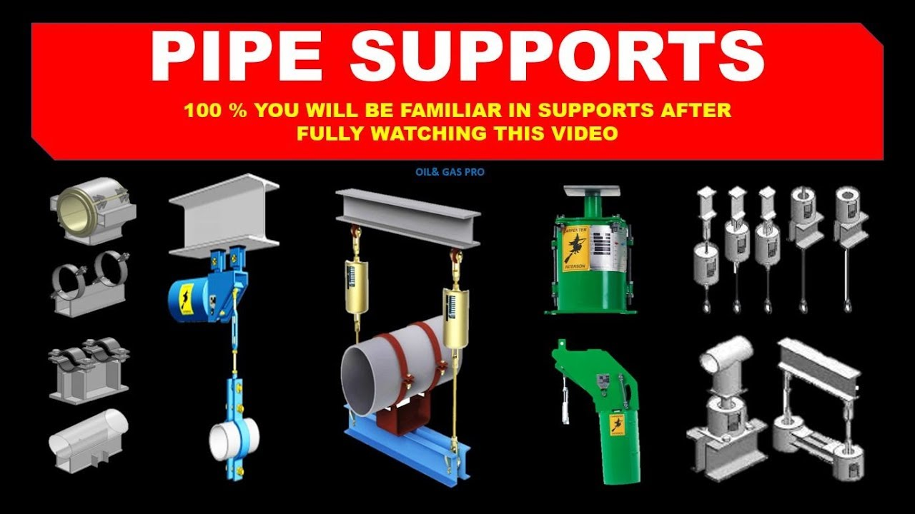
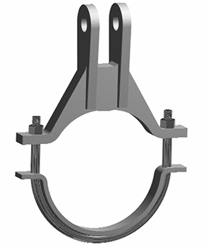
Mechanical/ Piping
Piping --- N/W Models, Thermal Expansion & Pipe Support Models

Slide 7
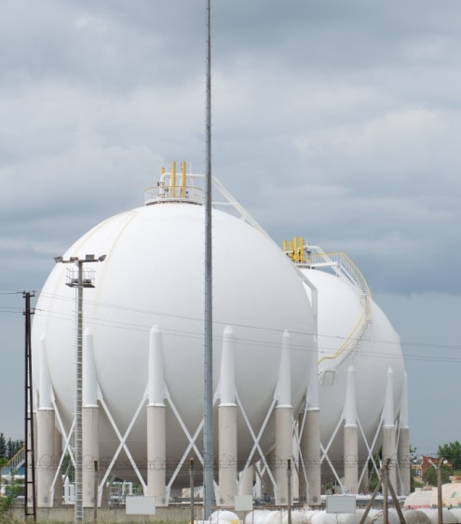
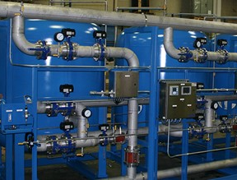
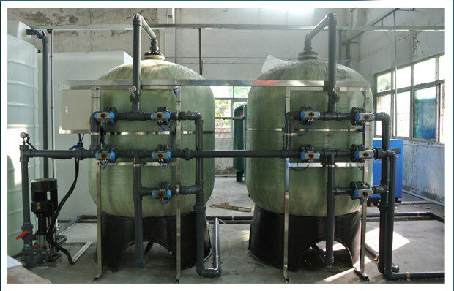
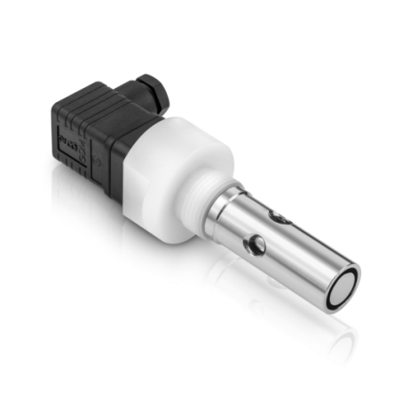
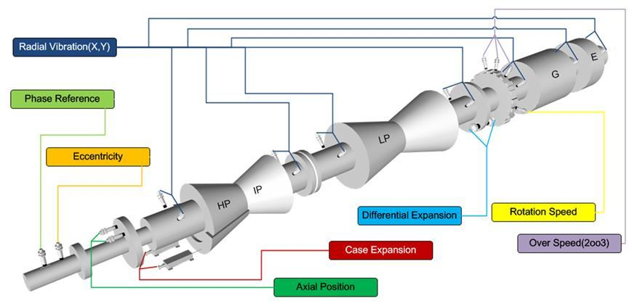
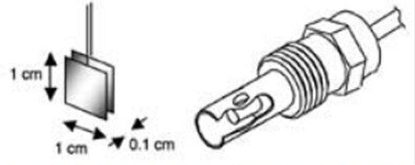
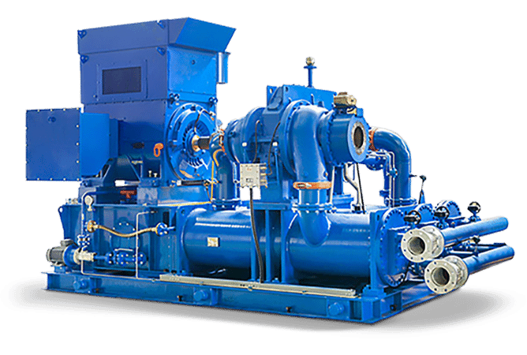
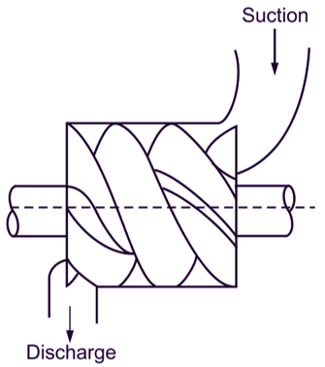
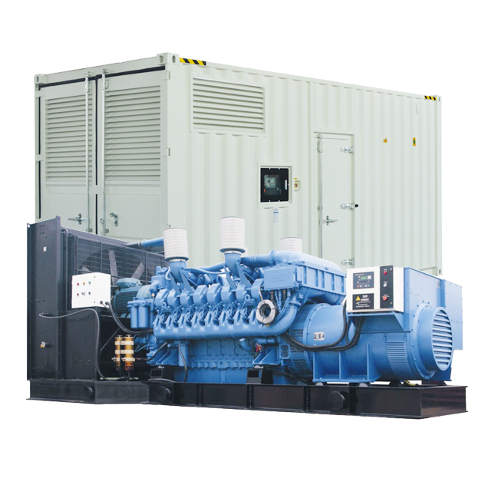
Mechanical/ DGs, Process Eqpt.
Electro-Chemistry, Ion-X Models, pH, K, etc.
Corrosion Models
Turbo-Visory Systems
Air Compressor Eqpt. Models, Inter-cooler Models, etc.
IC Engine Models, Heat-Transfer with JCW of DGs, Synchronous Gen. D-Q Axis Models

Slide 8
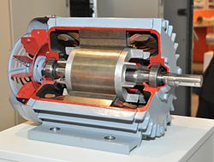










Electrical, Power Supplies/VFDs, Power Devices, etc.
D-Q Axes Framework/State-Space
Transfer Fn., State-space, Freq. Domain Models

Slide 9




Electrical, Switchgear & Protection Relays
Transfer Fn., State-space, Freq. Domain Models

Slide 10






Instrumentation, Actuators
Transfer Fn. Models, State-Space Models, Frequency Domain Models

Slide 11






Instrumentation, Process Sensors
Rise-time, BW, Tr.Char. SS-Char., etc.

Slide 12








Instrumentation, Process Sensors
Time Constants, Rise-time, Peltier/Seebeck effects, etc.

Slide 13




Typical Process Loops
Characterizing Loop Performance

Slide 14


Understanding Process Control Loops
Modeling Loops, Component Transfer Functions, Disturbance Transfer Functions, Performance Analysis of Controllers -- Open-Loop & Closed-Loop

Slide 15


Pressure Measurement
Pneumatic Signal
Header
Control Valves
Heat Source
Surge Tank
Discharge
Suction
Pumps
Characterizing Segments of Loop
Heat Exchangers
Secy. Flow
Primary Flow
Loop Performance Monitoring

Slide 16
Measurement Uncertainty, Errors & Estimation and EMI Aspects
Earlier Maintenance Paradigms
EMI Shield – Conducted/ Radiated
Process
Systems/ Piping/ Roto-Dynamic Eqpt./ Structures
Analog/Digital/μC Systems/ ASICS
Parameter Monitoring/Alarms / Trips
Sensor/
Transducer Uncertainty Assessment
Error Budget in Signal Conditioning
Cable Selection
Computer/ Server/ Historian
Time Constants
HMI
Algorithm Solvers/ Number- Crunching/ Estimation/ Data-Processing/ Spectroscopy

Slide 17

Integrated Sensing & Smart Control Concepts for Systems, Structures & Equipment/Component (SSE/SSC)
On-Line/Real-Time Monitoring of SSEs
Process
Systems/ Piping/ Roto-Dynamic Eqpt./ Structures
Embedded Sensors/
Actuators/ Controls
EMI Shields
Parameter Monitoring/ Alarms/Plant Protection
Cloud
WSN or IOT Devices
Signal Reconstruction/
Data Analytics/
Error Computation/ Cancellation
Estimation of Noisy Data/Signal
Data Servers/ Historian
Actuators for Performance Improvement
Algorithm Solvers/ Number- Crunching/ Estimation/ Data-Processing/ Spectroscopy

Slide 18
Incorporating the Information Back-bone in Industrial Facilities
Mechanical/ Structures, Piping, Roto-Dynamic Eqpt., DGs, Process Eqpt. etc.
Electrical, Power Supplies/VFDs, Power Devices, DGs, etc.
Instrumentation, Process Sensors, Chemical-Electro-Chemical, Domain-specific Inst.
Computer based Systems, Embedded Real-time Sys. & OS, DAC, Historians, Alarm-Trip Annunciations, etc.
Hybrid/Empirical Models of Systems, Structures, Eqpt. Inst.
Sensors, Signal Conditioning/Recovery, Data Acquisition
Embedded Computer based Systems for Controls
Decision Making & Auto-Closure of the FDD Loop
Cyber-Physical Systems
Prompting Human Operator on Actions to be Taken / Prompting/Initiating Maint. Action

Slide 19







Plant-wide Monitoring --- Evolution of Control Room Design/Layout
HMI, Cybernetics & Cognitive Engineering
Ergonomics & Anthropometrics
Data Mining/ Future Decisions on Mined Data
On-Line Data Processing/Intelligent Alarms/System Alerts/
Automated Decision
Increased use of SCADA & XR tools

Slide 20


Duplicating Physical Assets in Digital form
Creating Digital Twins

Slide 21

Digital Twins for Equipment
Continuously Updated with Real-time Data

Slide 22


Continuous Updating with Real-time Data
IOT/WSN Devices
Continuous Performance Analysis

Slide 23





